Slide 1

Gap Responsible
Understanding Defensive Line Player Value by Addressing Play-Specific Context and Player Responsibility
by Andrew Rogan
Assisted by Robert Bernhardt

Slide 2
Table of Contents
Research Considerations Slides 3-12
Econometric Methodology Slides 13-19
Results Slides 20-33
Conclusions Slides 34-38
Limitations and Proposals for Future Analysis Slides 39-41
Appendix Slides 42-64

Slide 3
Research Questions
Based on the 2019 SIS Player Data for weeks 9-17:
1. Which is the most valuable defensive line position? You can define the positions however you like.
2. What is the nature of the distribution of talent between the defensive line positions, as you define them?
3. a. In which in-game situations would the answer to Question 1 change?
b. In which roster construction situations would the answer to Question 1 change?

Slide 4
Our Approach
Estimating Marginal EPA for defensive front players
Our strategy is to quantify the Expected Points Added above baseline (“Marginal EPA”) of defensive linemen and linebackers in the NFL
From this we determine the relative dispersion of talent at any given position or alignment
Primary conceptual considerations
The model compares the EPA of plays with a given player to plays without that player. By controlling for numerous factors, we argue the only difference between such plays is the presence of a particular player, suggesting any difference in EPA is attributable to that player.
Controlling for:
Defensive front, defensive line
Situation (down and distance, time remaining, location on field, etc.)
Defensive lineman’s alignment, defensive lineman’s distance from the point of attack
Opposing offense and defensive team
Rejection of individual performance statistics (sacks, tackles, interceptions, etc.)
Replace performance statistics with the use of “agnostic” econometric modeling that projects the added value above baseline/replacement arising from a player being on the field, irrespective of traditional statistics
Given the fact that defensive linemen rotate in and out of the game frequently, this is the perfect position group to take this approach with

Slide 5
Primary Considerations
1. In football, no two plays and no two players are exactly alike
Much of current statistical research into player valuation and game-performance does not account for a great amount of play-specific variation and football/schematic–specific variation
Coaches are frequently skeptical of player evaluation through analytics because they do not factor in a player’s responsibility on a given play, the technique he must utilize, his matchup, and the overall difficulty of his assignment
2. Common individual performance statistics are extremely misleading
Sacks, tackles, TFLs, interceptions do not account for the impact of teammate contribution, scheme, and situation
See slides 60-64 of appendix for further discussion

Slide 6
Positional Considerations
There is a wide variety of schematic responsibility across the defensive line. This presents several sources of variation that must be controlled for in analysis:
Varying responsibility within positions (intra-position variation)
Different alignments (ex: 1,3,5,2i, etc.) are responsible for different responsibilities
A 1-technique and a 0 technique are both defensive tackles (and both are A-gap defenders), but 0s are frequently tasked with playing 2 gaps in the run game, whereas 1-techs are more frequently asked with playing 1 gap, and are also generally more likely to contribute in 1-on-1 pass rush situations. Responsibility and skillset utilized are quite different even though both are DTs.
Different defenses require different responsibilities (inter-defense variation)
It is therefore reasonable to assume that variance of skill occurs within each position, as different responsibilities may be more valuable or more difficult (e.g. a 3-tech vs. a 4i)
A 4i is responsible for gap-stuffing and player control, with little pass responsibility, whereas a 3-tech is generally responsible for playing one gap in the run game and has more individual importance in pass rush (particularly in 1-on-1 pass rush situations). Even though these are both DTs and B-gap players, they require different skillsets and are thus pre-selected based upon their individual traits.
Intra-player variation
Given the variety of responsibility and skillsets across different alignments, a given player is almost certain to have different levels of effectiveness at any given alignment.
Further, most football coaches believe that effectiveness is determined by quantity of reps practicing or performing a specific assignment. As such, players who have taken few snaps at a particular alignment will likely perform less effectively in those roles.

Slide 7
Positional Considerations (continued)
Given the current data set, we choose to account for responsibility and individual player skills by identifying and evaluating players based off both their alignment (using diagram below) and the defensive front (formation) on any given play.
Technique Alignments
“Outside”
9
6
7
5
4
4i
3
2
2i
1
0
1
2i
2
3
4i
4
5
7
“Outside”
D
Y
C
B
A
Ball
A
B
C
D
Note: in the data 7-techniques are always identified as C-gap players—as “6i”s to the closed/tight end side, and as 3-pt stance players off the body of the tackle to the open side. “Outside” alignments are always D-gap defenders.
- Fronts (described in following slides):
- Odd
- Even
- Bear
- Goal Line
- Money

Slide 8
Front Identification
Fronts are often identified by the offense based off which of the interior OL are “covered” by the DL at the snap
For purposes of defensive line evaluation, identifying fronts is preferable to identifying entire defenses, especially given current data (ex: 4-3 and Nickel are different defenses on a high-level, but they are generally functionally equivalent for the DL, and treated similarly by the offensive line)
Almost all functional front possibilities can be classified into 5 basic front types:
Even (64% of observations in final data set)
Typically a four-man, single-gap front (4-3, 4-2-5/nickel, dime) with one guard covered and the center covered by DL (or both guards covered and the center uncovered)
Odd (24% of observations)
A 3-man front that involves either one-gap or two-gap (or both) DL (3-4, Quarter/3-man rush), with the center covered and guards covered (in rare instances, just one guard covered but the center and other OG uncovered)
Bear (also known as a “triple” or “90” front, 7% of observations)
Five-DL front used in short-yardage situations or against heavy personnel, with the center covered and both guards covered
Money (5% of observations)
Pass-rush situation front with none of the interior OL covered
Goal Line (.1% of observations)
Goal line/short-yardage situation front with both guards covered and the center double-covered (defense attempting to simply cancel gaps)

Slide 9
Categorizing Front Types
Given the front categories described in the previous slide, front type can be determined from the given data by simply counting the number of defensive linemen in the “cylinder,” the area from guard to guard (also known as the “guard box”)
Cylinder count: 1. Therefore this is an “odd” front.
T
N
T
Odd: Cylinder Count = 1
Even: Cylinder Count = 2
Bear: Cylinder Count = 3
Goal Line: Cylinder Count = 4
Money: Cylinder Count = 0
CYLINDER
Go to slides 44-49 for more front identification diagrams

Slide 10
Relation to the Play (run plays)
On a given run play, it is reasonable to assume that not every defensive lineman has the same degree of responsibility and that defensive linemen farther away from the ball likely have less of an impact on a play’s success than those closer to the intended gap
See slides 56-58 for conceptual diagramming of this
The current data set provides alignment of defensive linemen, by side and by technique, and provides the intended gap of the ballcarrier
Both defensive player alignment and the intended run gap need to be quantified on the same scale in order to account for their degree of importance within the play
We created a linear scale (shown on slide 11) that quantifies the number of gaps away a player is from the intended run gap

Slide 11
Gap System
Our Linear Gap System
1
2
3
4
5
6
7
8
6
7
5
4
3
2i
1
1
2i
2
3
4i
4
5
7
9
4i
2
0
D
C
B
A
Ball
A
B
C
D
Y
1
2
3
4
5
6
7
8
Defensive Players are numbered based on the gap they are in on the snap
Ex: A defense’s left 3-technique and left 4i are both B-gap players, and are both therefore considered to be in the 6 gap on the snap
Note: .5s indicate head up alignments (ex: a defense’s right 4-tech would be labeled 2.5)
Offensive runs are numbered on the same scale, with the number indicating the intended gap

Slide 12
Quantifying Gaps Away
1
2
3
4
5
6
7
8
Play run to opposite B gap
Opposite Side 4i
Defensive Left B Gap (6 Gap)
Gaps Away
1
2
3
T
X
Play Direction: Left
Intended Gap: Offensive B gap (3 gap)
6 Gap – 3 Gap = 3 Gaps Away
B

Slide 13
Econometric Methodology
“Agnostic” modeling
To calculate Marginal EPA without the use of individual performance/production statistics, we present 3 agnostic model sets that estimate the marginal value of a given player or alignment being on the field, irrespective of production statistics
In other words, the model projects the added benefit to EPA (above or below replacement) when a given player is on the field
Estimating Marginal EPA
We set LB or DL players with <100 snaps as the baseline, assigning them as the omitted factor group in the regression output
Thus, coefficients for the player/position’s Marginal EPA will project EPA “above or below baseline/replacement” per play
When all such coefficients are aggregated, they will indicate the total magnitude and relative dispersion/variance for each position or alignment
NOTE: the goal of estimating marginal EPA is not to perform precise individual player valuation
Rather, the data in aggregate will indicate the relative importance and dispersion of talent within each position/alignment, rather than determine the value of any one particular player
Assigning a base level composed of all types of defensive front players allows us to grade all positions on the same scale
Individual player estimates are unbiased, but noisy, hence they are not intended as an exact player evaluation

Slide 14
Structure of Models (continued)
Model 1
Naïve Model: situational and team controls, with player-specific individual effects, aggregating effects based on roster position (LB, DE, DT)
Models 2a, 2b
Determine which alignments/roles are most important in each front over the season
(Front-Specific, Alignment-Based Models, subsetting for even and odd front plays)
Models 3a, 3b
Determine who is most important on a given play type, using gap proximity and alignment
(subsetting for run and pass plays)

Slide 15
Econometric Process (Model Set 1)
Model 1 (Naïve model that only accounts for situation and individual/roster position effects)
EPA= β₀ + Σβ_{i} Player + β situational controls + β team effects controls + ε
Estimate Marginal EPA coefficient for each qualifying player in the league (OLS Regression)
Extract and aggregate coefficients by roster position, deriving mean and relative dispersion for each position
Note: in this model we aggregate coefficients based upon roster position. In the following models we estimate coefficients based upon technique then group based upon technique and front type)

Slide 16
Econometric Process (Model Set 2)
Model 2 (Front-based model that accounts for situation and individual/alignment effects)
EPA = β₀ + Σβ_{i} Player Technique + β situational controls + β Player Controls + β team effects controls + ε
Subset for even and odd fronts
Concatenate Player and Technique, eliminating techniques that a given player played less than 16 snaps at over the course of the data set (to limit noise caused by small sample sizes)
Calculate coefficients by Player Technique, thus estimating the coefficients for each player in each alignment
Group technique coefficients into positions, determining position based on front (see slides 51-52 for more thorough grouping explanation)
Extract and aggregate coefficients for grouped positions, generating mean and SD
-Note: We also do not estimate a coefficient at any alignment at which a particular player takes less than 16 snaps (considering players with few snaps at an alignment may perform worse at such alignments due to a lack of experience or practice). Additionally, since this model examines pass and run plays simultaneously, we also included a pass indicator.

Slide 17
Econometric Process (Model Set 3)
Model 3 (Run and pass-specific models that account for situation and individual/roster position effects, as well as proximity to the intended gap on run plays)
EPA = β₀ + Σβ_{i} Player + β situational controls + β Player Controls + β Player * gapsaway + β front controls + β team effects controls + ε
Subset for run and pass plays
Estimate coefficients for individuals as well as for each player’s gaps away (include in run model only)
Aggregate coefficients by position for pass model (aggregate techniques into positions in pass model)

Slide 18
Additional Data Cleaning Notes
Factoring out players with more than 550 snaps
It would be impossible to separate a player’s contribution to play EPA from the team’s EPA if he played every snap
We assumed that players included in the final data set should have played less than roughly 85% of their team’s snaps
Eliminating “Off Ball” alignments
Since we cannot determine technique/alignment for these players it is impossible to group them into accurately positions
“Off Ball” was extremely rare for players who are listed on rosters as defensive linemen
We do not consider inside linebackers in our analysis, only outside linebackers at certain alignments
Eliminating spikes and kneels
Important note: EPA is coded from the offense’s perspective.
Higher (positive) EPAs indicate better offensive performance on a given play, lower (negative) EPAs indicate better defensive performance

Slide 19
Additional Controls
Absscorediff: The absolute value of score differential. |DefensiveTeamScore-OffensiveTeamScore|
ToGo: Yards to go to gain a first down or touchdown
Down: Factor variable that represents current down on that play (ie: 1st, 2nd, 3rd, 4th)
Pass : Indicator variable that shows whether the play was a pass or run
Distancetogoal: Measures the yards a team is away from the opposing team’s endzone
TimeLeft: Time remaining in the game (renamed from initial data set)
Defense_Home: Binary variable that indicates if the defensive team is also the home team
Scramble (run data set only): Binary variable that indicates if a run play was intended to be a pass but resulted in a scramble
Shotgun: Binary variable that indicates if the offense was a shotgun formation at the snap
Redzone: Binary variable that indicates if offense has the ball inside their opponent’s 20 yard line
Lastfourfirsthalf: Binary variable that indicates if there are less than 4 minutes left in the first half (used to capture non-linear relationship between EPA and game time)
Lastfoursecondhalf: Binary variable that indicates if there are less than 4 minutes left in the game
Fronttype: Factor variable that controls for front structure (only used in full data models)
NameAlignment: Coefficient for a specific player at a specific alignment
OffensiveTeam: Factor variable indicating which team is on offense, thus controlling for team effects (49ers are the base group)
DefensiveTeam: Factor variable indicating which team is on defense, thus controlling for team effects (49ers are the base group)
UsedDesignedGap: Indicates whether or not the runner carried the ball through the designed gap
Numberofrushers (pass data sets only): Counts the number of pass rushers on that play
ThrowDepth (pass data sets only): Measures the distance the ball traveled on the throw

Slide 20
Results

Slide 21
Model 1 Summary Stats

Slide 22
Model 1 Visualization

Slide 23
Model 1 Interpretation
Defensive tackles are more closely tied to play EPA than defensive ends and linebackers, as they typically have the greatest average effect on EPA because they have the most negative mean
Given the higher standard deviation and visual dispersion for defensive ends, DEs are the most volatile and widest ranging position in terms of performance
Linebackers perform the worst relative to the baseline, indicating they are the least tied to team performance and EPA
Note: in all models, linebackers are included only when they are on the line/at an edge alignment. The models therefore cannot account for the value they may have when in a coverage alignment, as such alignments are not in the data set.
There are considerably more players at the high end of the spectrum for DEs than DTs and LBs, suggesting that there are more truly “transcendent” or “superstar” defensive ends than tackles or LBs

Slide 24
Model 2 Summary Stats

Slide 25
Model 2 Visualizations (by position)

Slide 26
Model 2 Visualizations (Odd alignments)

Slide 27
Model 2 Visualizations (Even alignments)

Slide 28
Model 2 Interpretation
Odd:
DEs and Edge defenders possess roughly the same mean Marginal EPA, indicating similar levels of importance
DTs, by comparison, are much less tied to performance, with a positive coefficient
Edge defenders are heavily clustered, suggesting that there is little disparity between an average edge and a good one in an odd front
Even:
Defensive tackles provide the highest average boost to EPA due to their negative coefficients
Defensive ends are more volatile than DTs or edges, with a greater dispersion of talent than Edges or Defensive tackles
It is important to note that some position coefficients are negative because the baseline is composed of all players in the entire data set who played any position. The positive coefficient is not worrisome because it compares the players of a given position to a baseline of players across the entire defensive front. It does not necessarily mean backups outperform starters.

Slide 29
Model 3a Results (run plays)

Slide 30
Model 3a Results (run plays)

Slide 31
Model 3b Results

Slide 32
Model 3b Results (pass plays)

Slide 33
Model 3 Interpretation
Run Plays:
DEs have the greatest average impact on EPA, followed by DTs and then linebackers, even when accounting for proximity to play
Linebackers, however, have the highest standard deviation, indicating that they have the highest varying degree of impact on run plays
Gaps away:
The positive mean of gaps away interactions for each position indicate that EPA will increase (from the offense’s perspective) the further away from the play that a given player
I.e. players closest to the point of attack have the greatest effect on EPA
This effect is greatest for DTs, which is intuitive because they are generally the largest and slowest players in the defensive front. Similarly, the effect is smallest for linebackers, as they are generally the smallest and fastest, and therefore can more readily contribute from further away from the designed gap.
Pass plays:
DEs have the highest average effect upon pass play EPA
DEs are also the most volatile, with the highest degree of dispersion of talent

Slide 34
Conclusions

Slide 35
Conclusions
Preliminary findings (Model 1) indicate that defensive tackles are the most important defensive line position, followed by Defensive Ends
Front-specific models (Models 2a and 2b) indicate that order of importance of positions depends on front
In Odd fronts, defensive ends and edge defenders are the most important by average Marginal EPA (with roughly equivalent value)
In Even Fronts, defensive tackles are the most important defenders
Talent distribution
In both even fronts and odd fronts, the distribution of talent is most widely spread amongst defensive ends. Defensive ends have a much more spread out distribution, indicating that there is a bigger disparity between a good DE and a great one than between a good and great DT or Edge

Slide 36
Conclusions (continued)
How do in-game situations affect the importance of certain positions?
Different positions/alignments are of more importance in run and pass plays
Defensive ends are more important on pass plays than DTs or edge players
In aggregate, DEs are most important on run plays
However, on a given run play, the most critical players are those closest to the point of attack, regardless of position.
When the defensive team is leading late in games, opposing teams become more likely to pass in an attempt to preserve game time. As a result, the value of defensive ends further in situations such as this, and DTs become more important relative to edges.
When the defensive team is trailing late in games, the opposing team generally becomes more likely to run in order to kill the clock. As a result, edge players become relatively less important compared to DTs.

Slide 37
Roster Construction Conclusions
Simple takeaways for roster construction:
In even fronts, most important defensive players are defensive tackles, but there is less dispersion in talent amongst DTs than amongst DEs. It is reasonable that the largest contracts should be reserved for top DEs, who are more likely to be transcendent players and significantly better than their peers.
In odd fronts, DEs are more important and and they also have a higher dispersion. It is again reasonable for these players to get the biggest contracts.
In this project, we have not accounted for the rate at which any team uses any of the positions that we have outlined
Teams may utilize even fronts and odd fronts at varying ratios, and some utilize exclusively even or exclusive odd
Given the varying importance of position/alignment across front types, front offices utilizing a similar approach to us should estimate the number of snaps they expect to utilize a particular front or personnel group in order to weight for the importance of each position

Slide 38
Additional Conclusions
Edge players in odd fronts are possibly overvalued
Players who align as “outside” alignments or 9-techs in 3-down linemen fronts are often considered to be the most important pass rushers in such fronts, but evidence from this study suggests that defensive ends are more important to team success
Odd DEs (4is, 4s, 5s, and 7s) are likely undervalued
As discussed above, edge players are often considered most important in odd fronts
As expected, on run plays, proximity to the ball determines a player’s effect upon EPA
In aggregate, DEs are most important on run plays.

Slide 39
Limitations and Areas for Further Analysis

Slide 40
Limitations
Gap and assignment variation
The current data does not indicate the players assignment
Although fronts ask similar things of their players, we don’t know from the given data exactly what they were asked to do.
Somewhat of a remedy for this would be to record which gap the player played after the snap (ie: if he slanted to another gap or got reached)
Situational controls
Due to time constraints we were unable to precisely model the effects that various situations have upon EPA
For example, time remaining may have a non-linear relationship with EPA. We attempted to control for this in a number of ways (time left in game, indicators for whether or not there is less than four minutes remaining in the first half or the game). It would be ideal to understand these relationships more precisely.

Slide 41
Further Analysis
Accounting for other players on the play
The model as it stands right now cannot account for the effect of other players that are on the field at the same time as any given player
Ex: if Joey Bosa is often on the field at the same time as Melvin Ingram, Bosa’s marginal EPA may benefit due to Ingram’s contributions
This is part of why we eliminated players with >85% of snaps
Future versions of our models maybe should include a way of controlling for teammate effects
It would be helpful to include info on all players on the field, including all linebackers and their alignment shades (eg.: 30-technique, 40-tech), as well as all defensive backs
Breakdown run and pass data sets by front type
Such a process would be preferable, but working with so many permutations of the model for us was not possible given time constraints
Include information on matchups
Who a given DL is matched up against on a given play
Offensive formation and personnel grouping
Would make it possible to identify over and under fronts
Defensive blitz type or stunts
Though difficult to group together exactly, blitzes can be at least be classified into a rough type
The same applies to coverage/shells
Include “directional gaps away” as an alternative independent variable to gaps away (described in appendix slides 53-55)
Could not incorporate due to time constraints
Play success binary as dependent variable
Logistic regression models
Further research into bear, goal line, and money fronts (not performed by us due to relatively small sample size)

Slide 42
Appendix

Slide 43
Front Identification

Slide 44
Odd
M
W
Schemes/Situations:
- 3-4
- 3-man rush
T
N
T
B
Q
Cylinder count: 1
Center covered, guards uncovered
B

Slide 45
Even
W
M
Schemes/Situations:
4-3
Dime
Nickel
General four-man rush
E
T
T
E
B
Q
Cylinder count: 2
Center covered,
one guard covered
B

Slide 46
Bear
M
W
Schemes/Situations:
Short yardage
Heavy offensive personnel
E
T
N
T
E
Y
B
Q
Cylinder count: 3
Center covered, both guards covered
B

Slide 47
Goal Line (cancelling gaps)
M
W
Schemes/Situations:
Short yardage
Heavy offensive personnel
E
T
T
T
T
E
Y
Center double covered, both guards covered
Q
Cylinder count: 4
B

Slide 48
Money
M
Schemes/Situations:
Passing situations
Dime
E
T
T
E
B
Q
Cylinder count: 0
Center uncovered,
both guards uncovered
B

Slide 49
“Even 2” (double 2 techs)
M
W
Schemes/Situations:
Passing situations (some rushing situations)
E
T
T
E
B
Cylinder count: 2. Thus, this is still an even front, even though the center is uncovered.
Center uncovered,
both guards covered
Q
B

Slide 50
Importance of Identifying Front
M
W
$
B
OLB becomes 6i
End reduces to 3-tech
N
B
E
E
Y
Cylinder count: 2. Therefore, offense will likely treat this as an even front, as it will act more like a 4-3, even though it is technically a 3-4 personnel.
In this situation, the defense has 3-4 personnel on the field (3 DL, 4L B), but has four stance players. Simply referring to this as a 3-4 would be misleading.
Q
B

Slide 51
Distinguishing Positions (Even)
W
M
(Edge)
(Tackle )
(Tackle )
(End )
(Edge )
E
T
T
E
B
Y
Players Grouped based on Gap:
DT’s=A and B Gap Defenders (1, 2i, 2, 3)
DE’s=C Gap Defenders (5, 7, 4, 6)
Edges=D Gap Defenders (9 and Outside)
Q
Note: 0s and 4is are rare in even fronts, but are classified here as DT’s, as they are A and B-gap defenders, and because players that utilize those alignments in even fronts most often have the body type and skill sets of DTs.
B

Slide 52
Distinguishing Positions (Odd)
M
W
(Edge)
(End)
(Tackle)
(End)
(Edge)
E
E
N
E
B
Y
Players Grouped based on Gap:
DT’s=A Gap Defenders (0, 1, 2, 2i)
DE’s=B and C Gap Defenders (4i, 4, 5, 6, 7)
Edges=D Gap Defenders (9 and Outside)
Q
B
Note: True 3 techniques are rare in odd fronts, but are classified here as DE’s since B-gap players are traditionally considered DE’s in odd fronts (ie: 4is).

Slide 53
Directional Gaps Away
“Playside”
Gaps to this side of the play gap are positive
“Backside”
Gaps to this side of the play gap are positive
1
2
-1
-2
-3
-4
Y
X
Play Direction: Left
Run gap: B gap
B

Slide 54
Directional Gaps Away Example 1
Play run to same side B gap
One gap to back side
Gaps Away
-1
T
X
B

Slide 55
Directional Gaps Away Example 2
Play run to same-side C gap
DE is two gaps to play side
Gaps Away
E
1
2
X
B

Slide 56
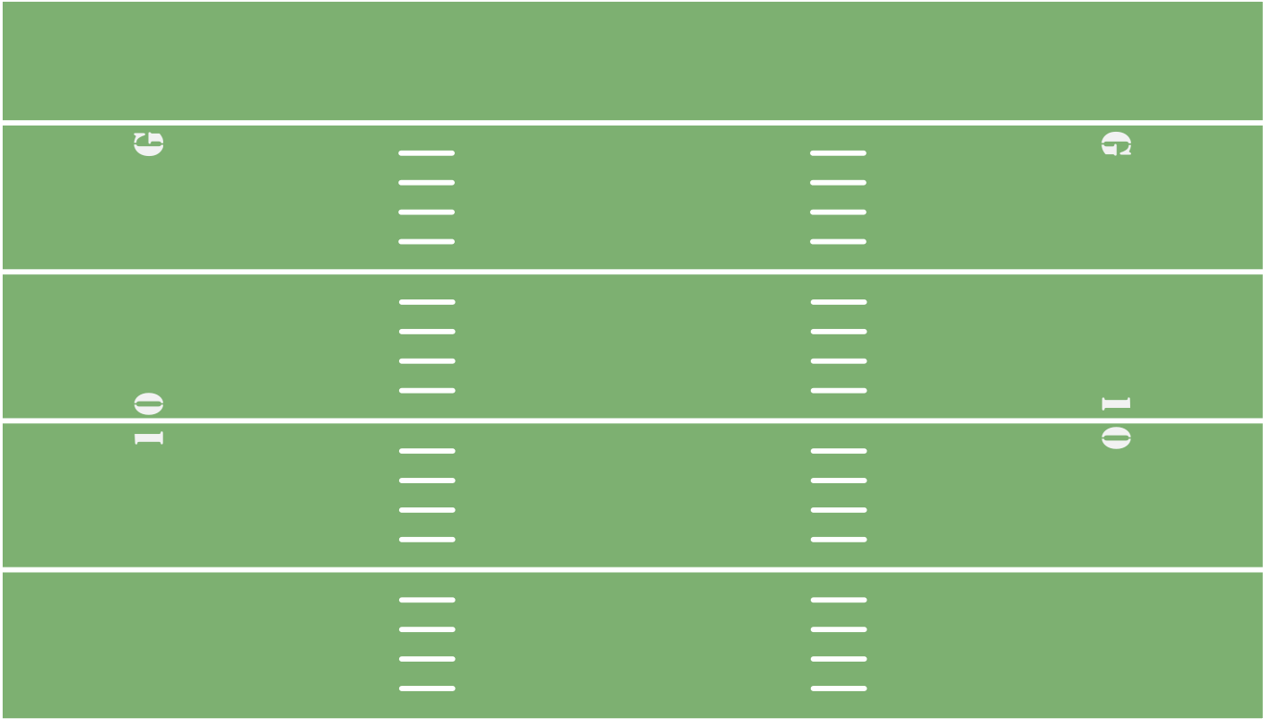
Relation to the Play
Weak Iso vs. Even (Over)
B
M
W
E
T
T
E
Y
Q
F
Backside end is 6 gaps away, not nearly as important as playside end, who can easily make a positive or negative impact on play due to his proximity to the intended gap
B

Slide 57
Relation to the Play
Weak Iso vs. Even (Over)
B
M
E
T
T
W
E
Y
Q
Most likely gaps to be used (if not designed gap) are adjacent gaps
F
B

Slide 58
Relation to the Play
Weak Iso vs. Even (Over)
B
M
E
T
T
W
E
Y
Q
Most likely gaps to be used (if not designed gap) are adjacent gaps
F
B

Slide 59
Highest Rated Player Alignments by Front (Model 2)
(Just off list at Outside: #6 Melvin Ingram, #7 Cameron Jordan, #8 Everson Griffin, #9 Marcus Davenport)
59

Slide 60
Fundamental Issues with Performance Statistics

Slide 61
Conceptual Problems with Production Stats
Since such a key aspect of our analysis is the deliberate ignoring of performance stats, the following slides outline examples of conceptual problems with using defensive line performance stats
Example 1: Player Control (diagram on following slide)
Player control is a scheme used in some one-gap or two-gap 3-4 (odd) defenses
The primary goal of defensive linemen in this system to control the offensive linemen in front of them in order to allow the linebackers to run free of blockers
If a team is utilizing player control schemes, their defensive linemen will generally have very poor performance/production stats, as their linebackers will accumulate most tackles and TFLs.
This can be accounted for by analyzing the team’s EPA when a player is on or off the field, as we have done in this analysis
61

Slide 62
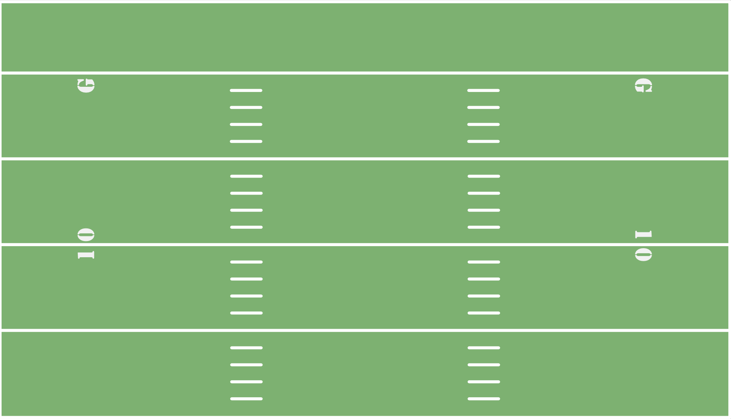
“Player Control” Fronts
M
W
B
E
N
E
Q
B
62

Slide 63
America’s Blitz
America’s Blitz (also known as ‘Blast,’ ‘Tornado,’ or ‘USA’)
America’s Blitz is a zone or man pressure (typically zone) that relies on a defensive linemen slanting two gaps in order to use up two offensive linemen and free up two rushers off the edge of the offensive line
In the diagram on the following slide, if the line slides away from pressure in a typical 4-man slide, the tackle will be responsible for a 1-on-1 against the 4i.
If the defensive end forces the guard and tackle to be slow on their exchange, the edge defender and inside linebacker will both come free off the edge, resulting in a 2-on-1 on the RB and a free rush on the quarterback
In this example, the inside linebacker and edge defender would be credited with a pressure and sack, even though the more important role defensively is arguably that of the defensive lineman who enabled them to get a free rush (as well as the center or quarterback who slid protection the wrong way, or the tackle who was fooled by the DE and was slow to recognize the blitz).
Again this can be controlled for by utilizing our “agnostic” econometric strategy
63

Slide 64
America’s Blitz
W
M
B
E
N
E
B
Two-on-one vs. back,
resulting in free rusher
Q
B
64

